Slide 1
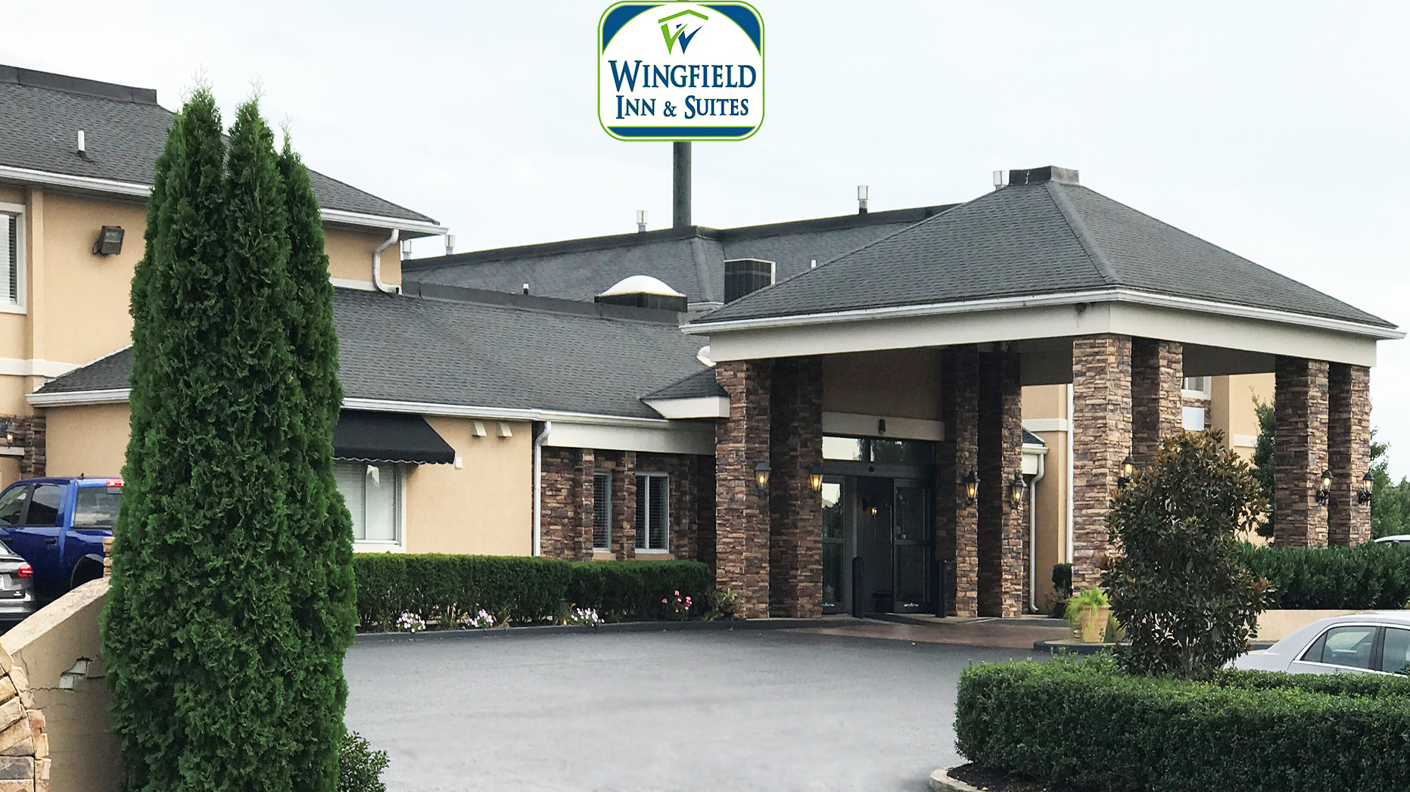

Slide 2
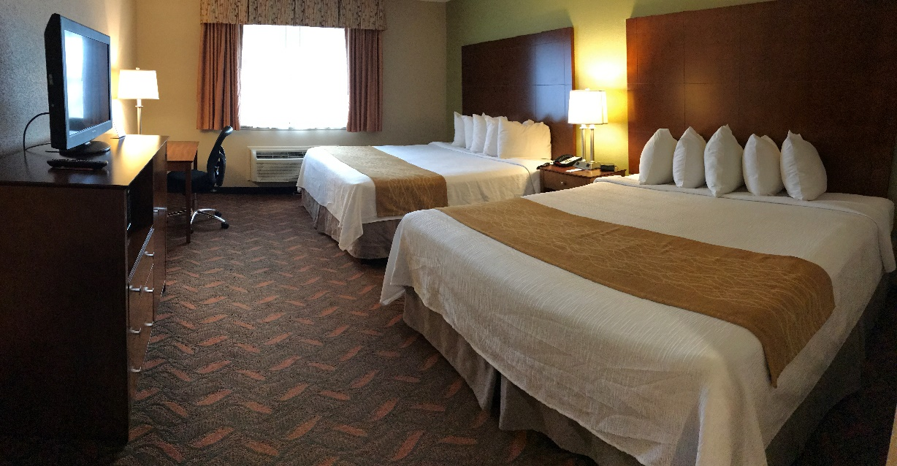
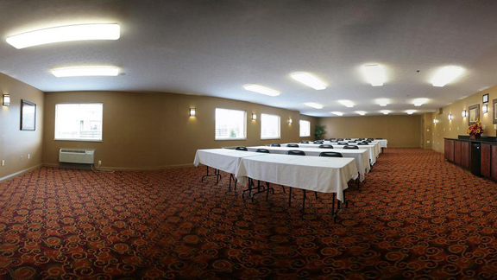
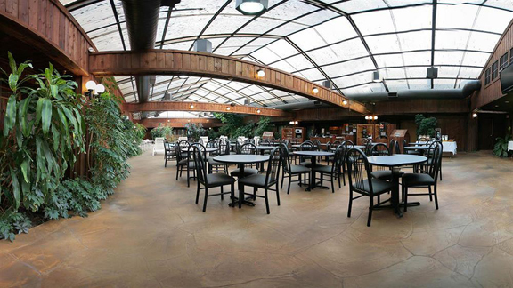
Wingfield Inn and Suites enjoys the perfect location. Nestled between Cracker Barrel and Ruby Tuesdays,
Guest Room
Restaurants Within Walking Distance!
Meeting Room
Atrium Gardens
www.WingfieldInnandSuites.com

Slide 3
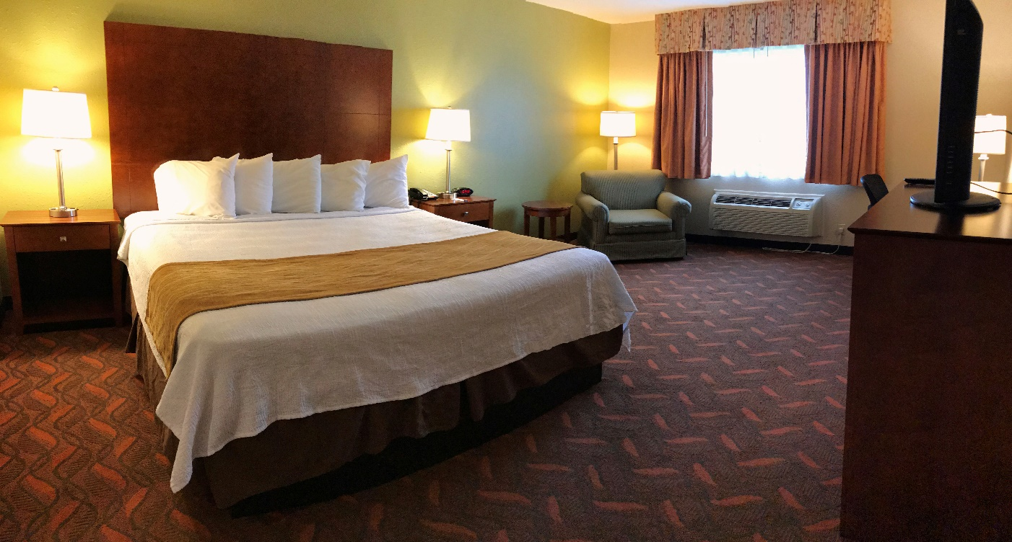
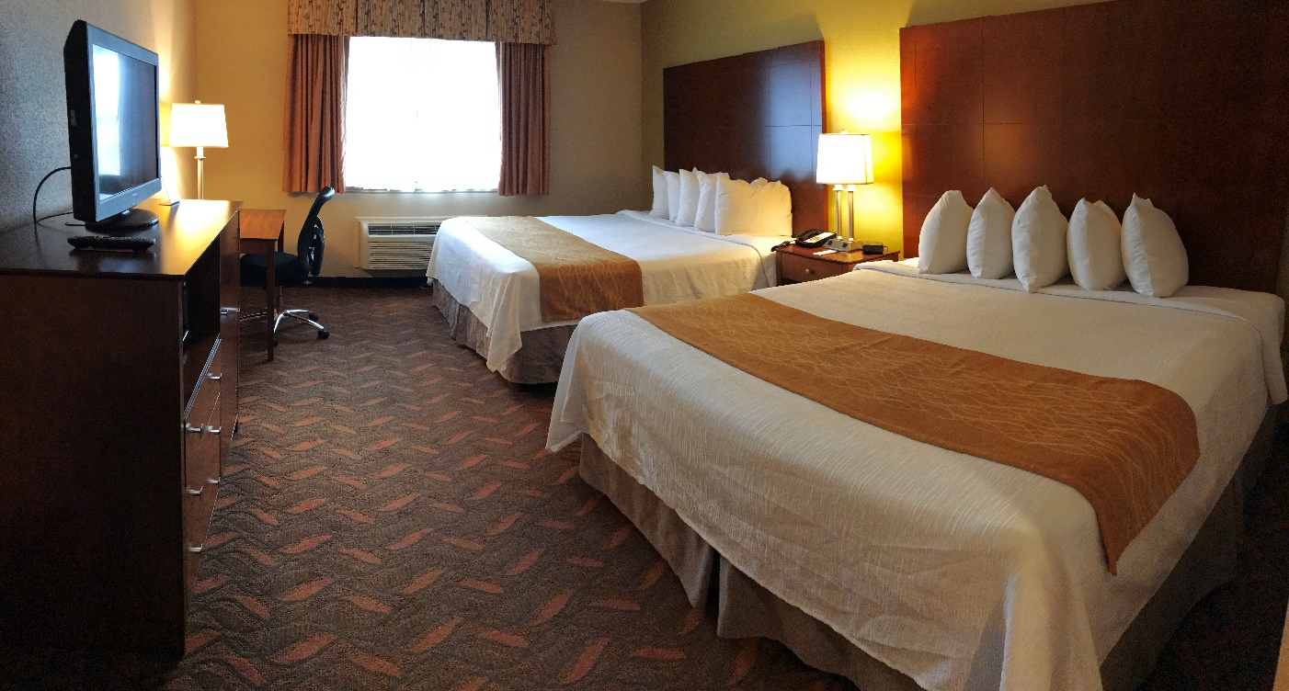
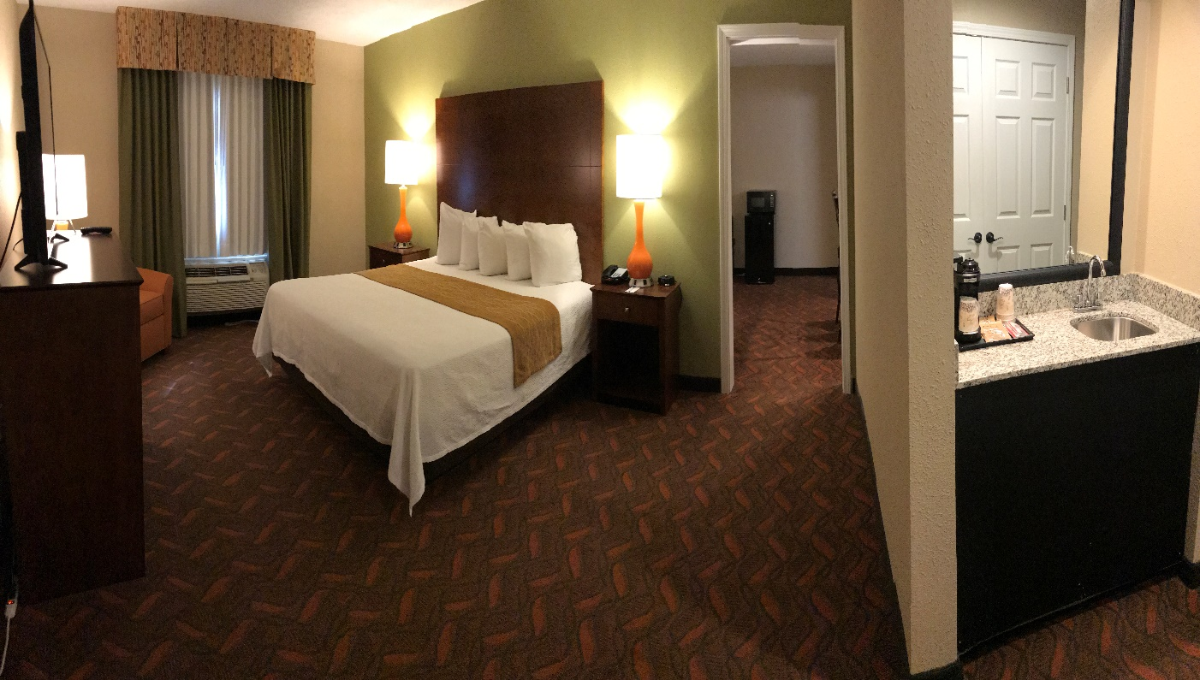
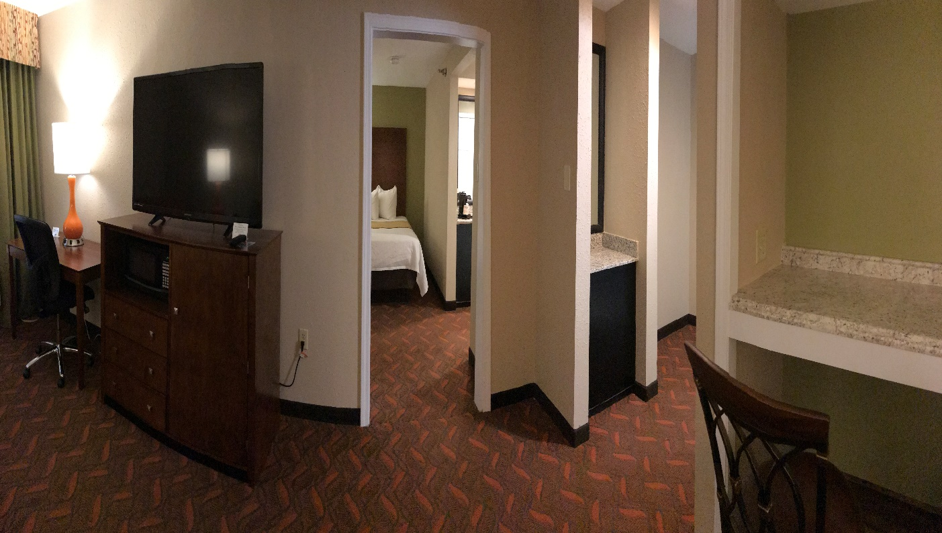
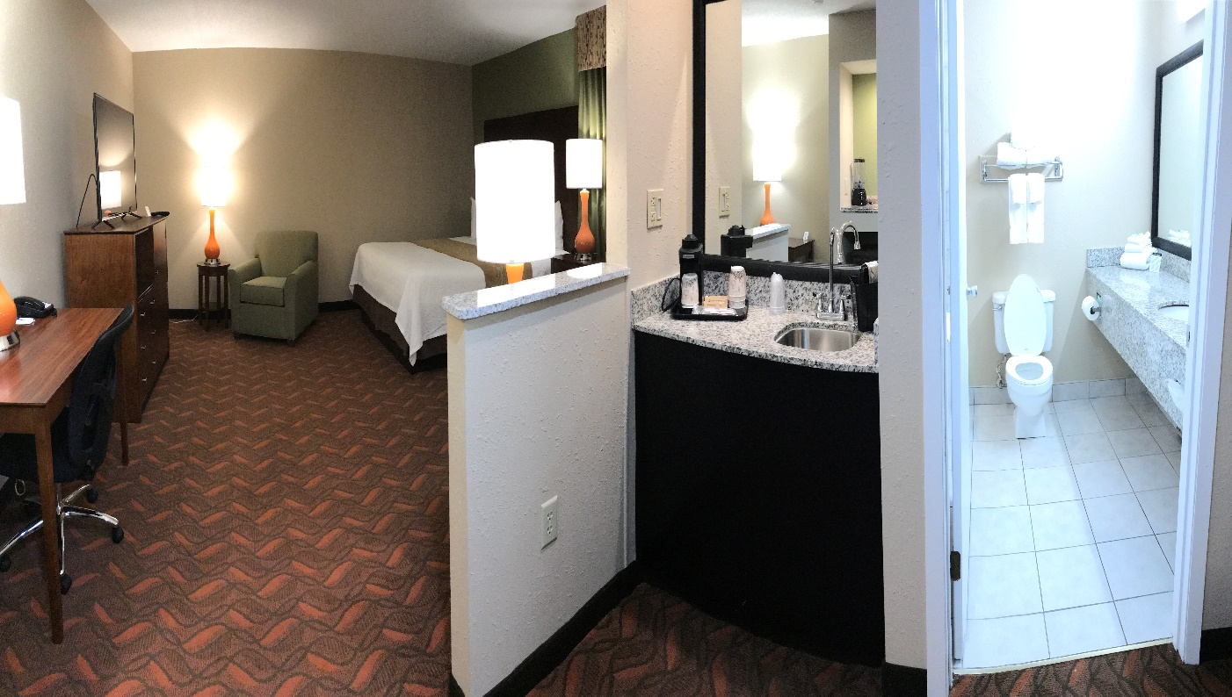
King
Two Kings
Suite
Suite

Slide 4
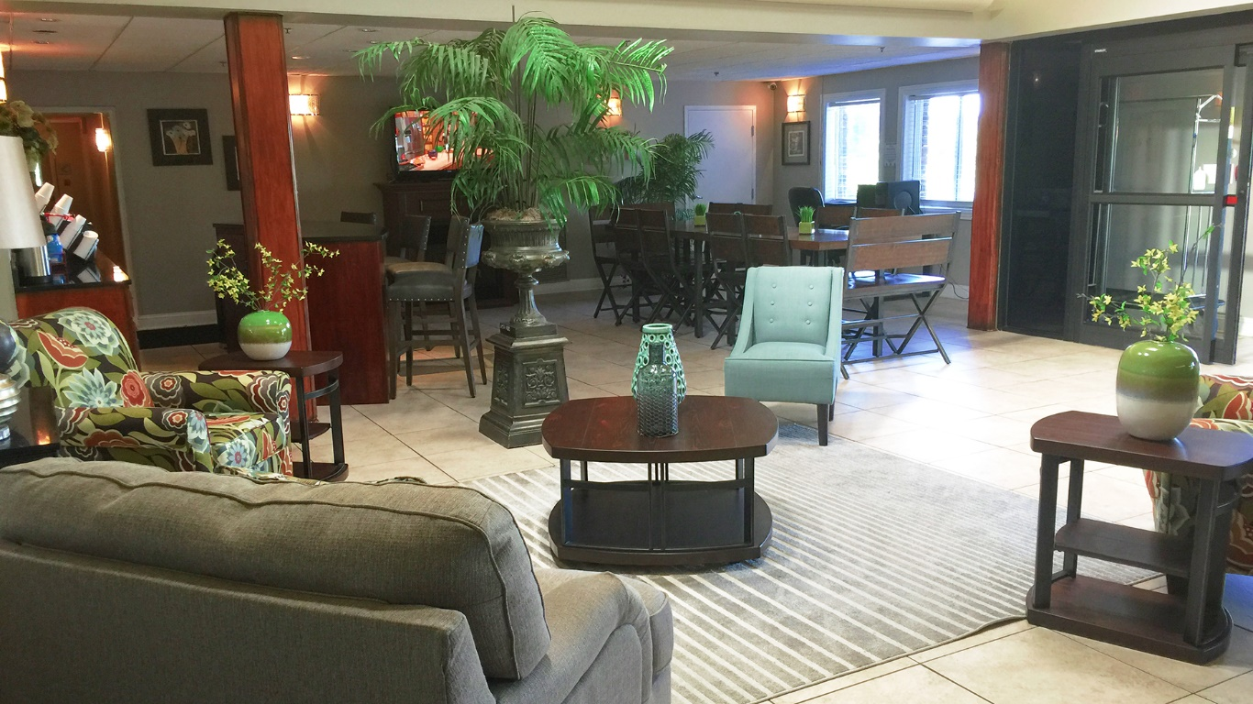
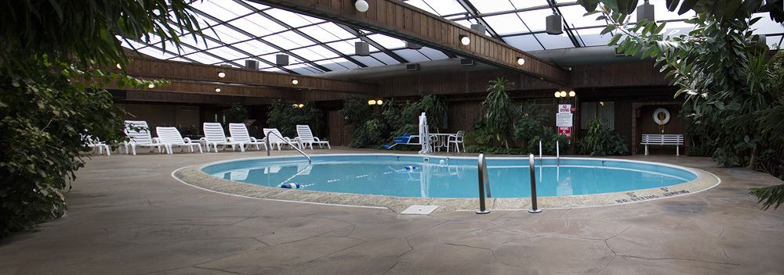
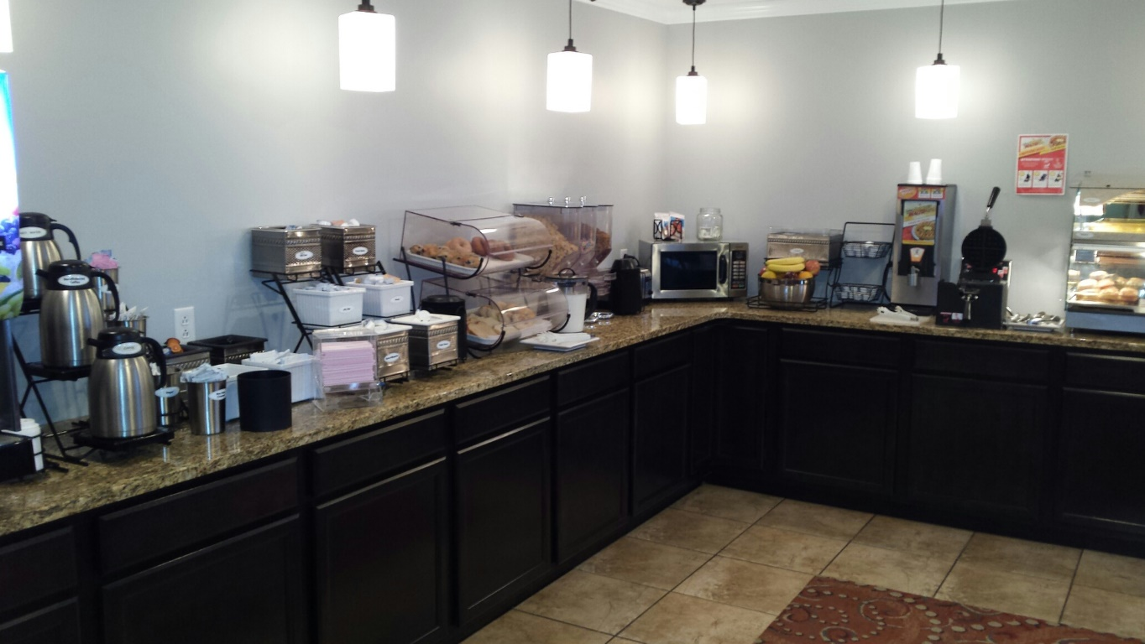
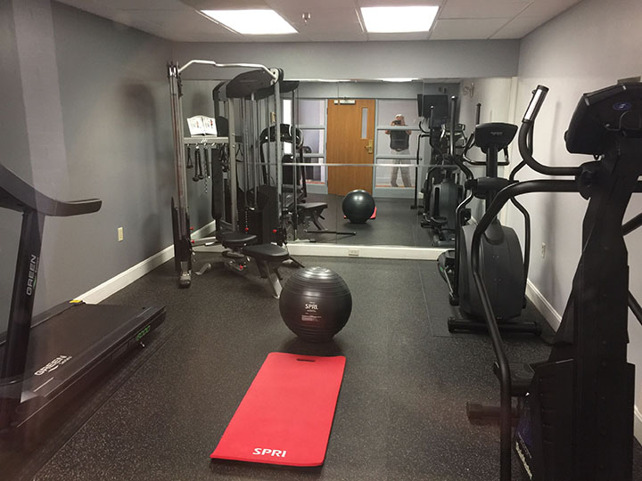
Lobby
Atrium Gardens
Breakfast Area
Exercise Room

Slide 5
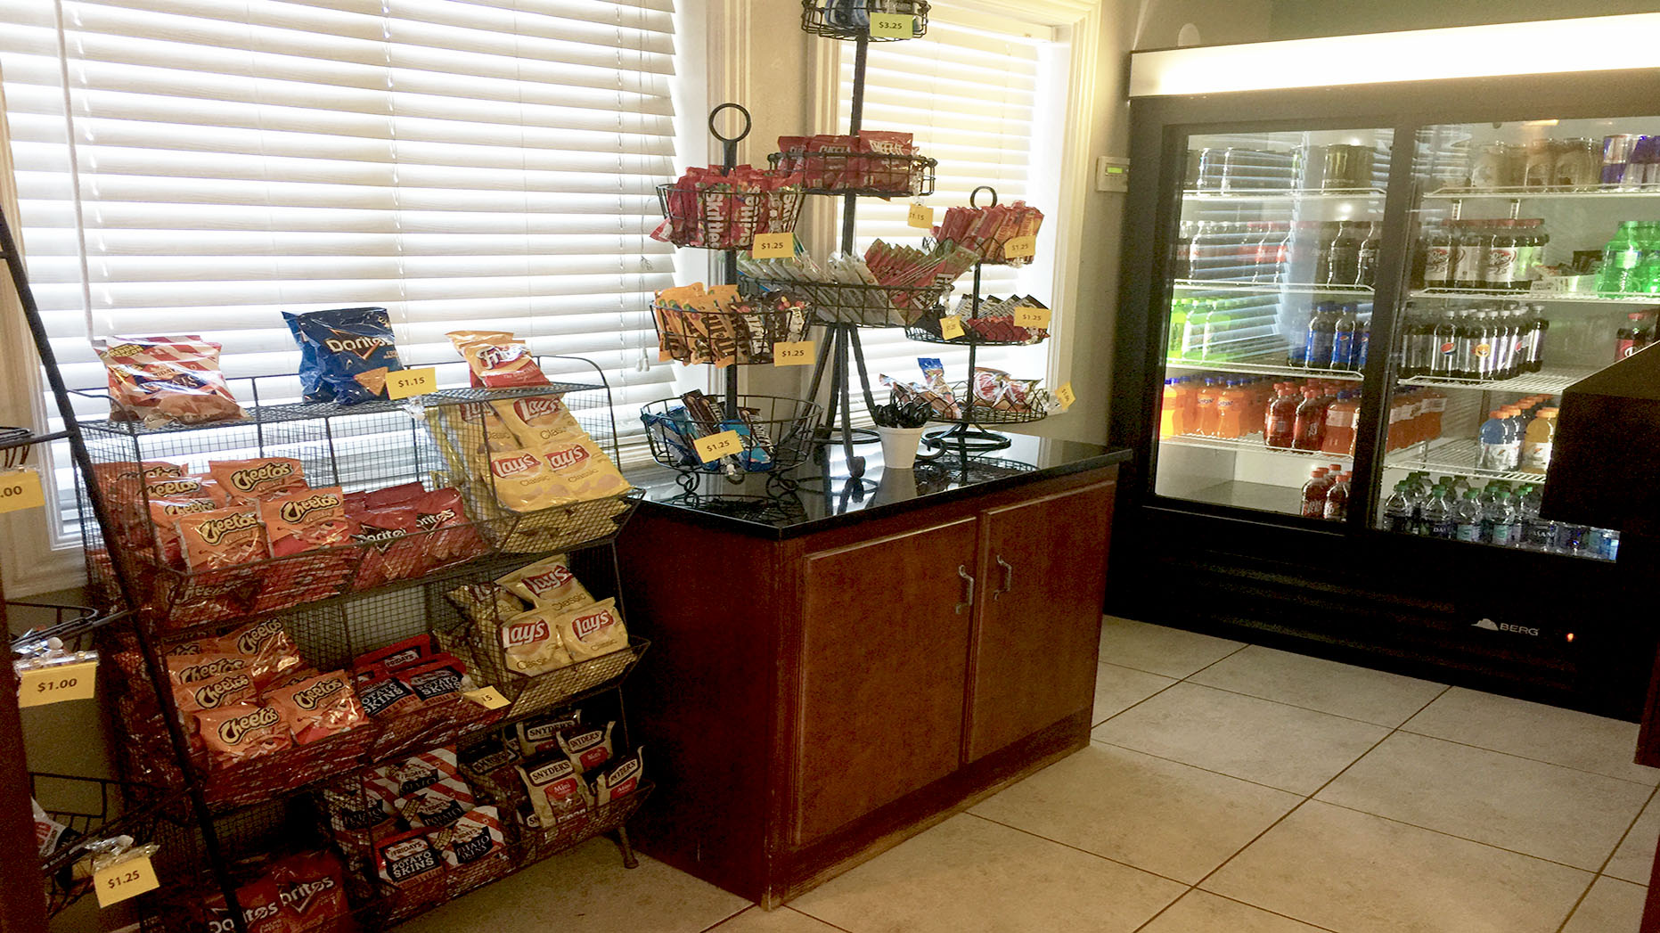
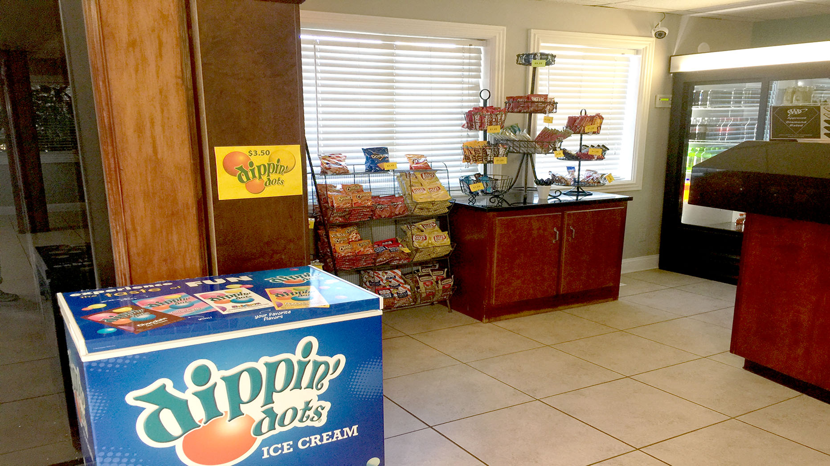
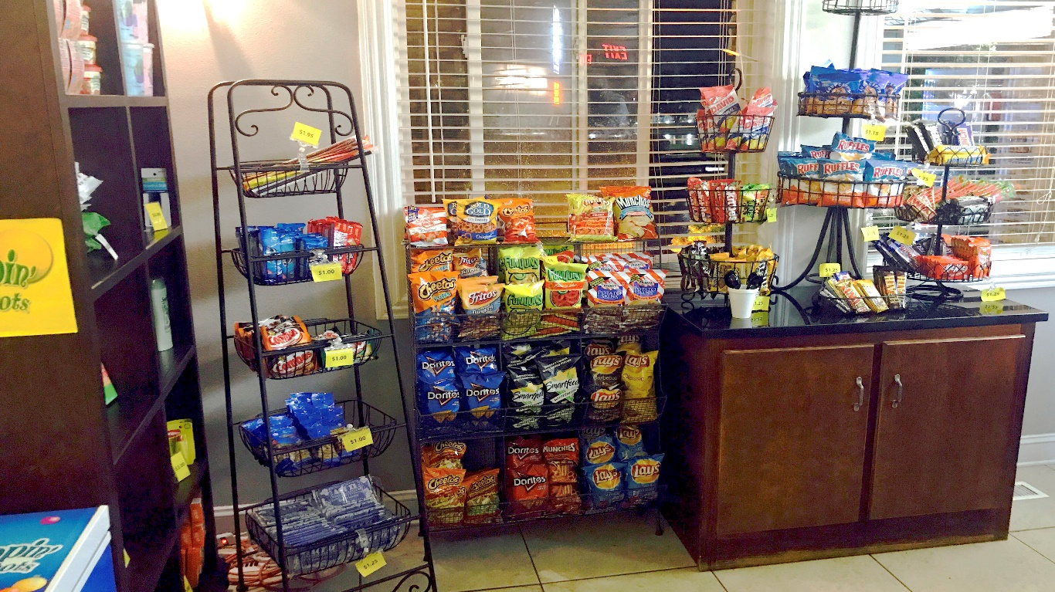
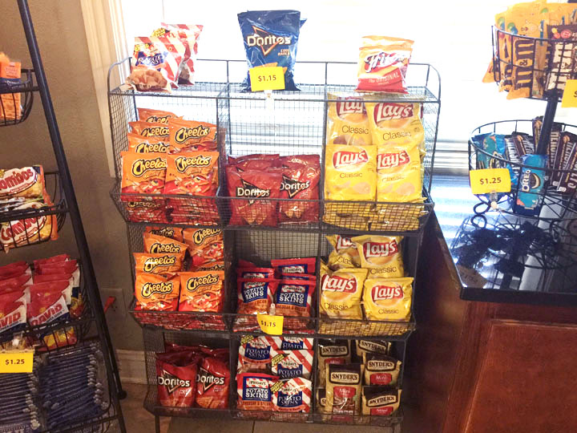
Sundry Shop
Sundry Shop
Sundry Shop
Sundry Shop

Slide 6
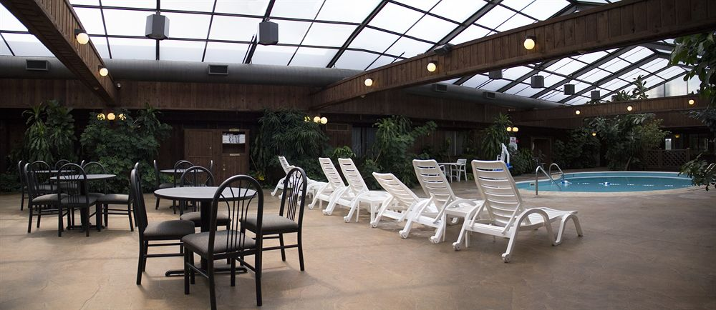
Atrium Gardens
Atrium Gardens
Atrium Gardens

Slide 7
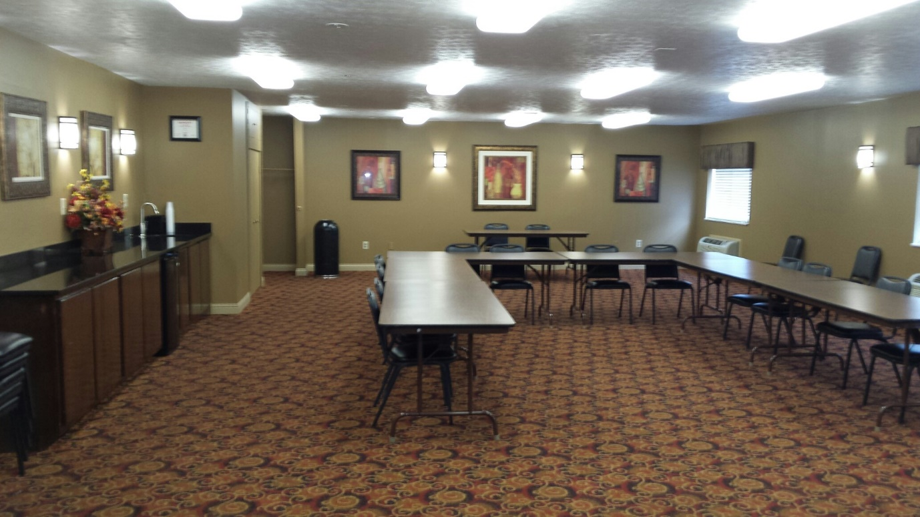
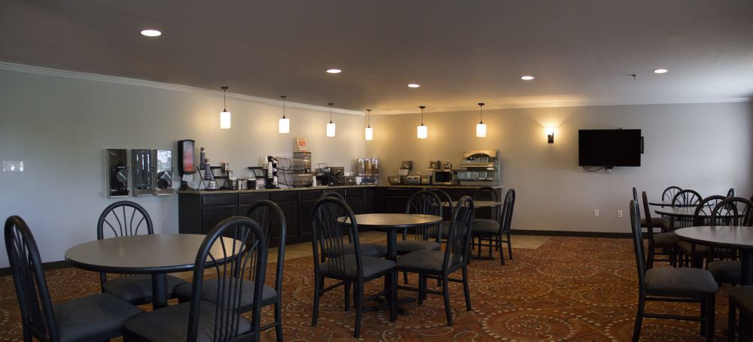
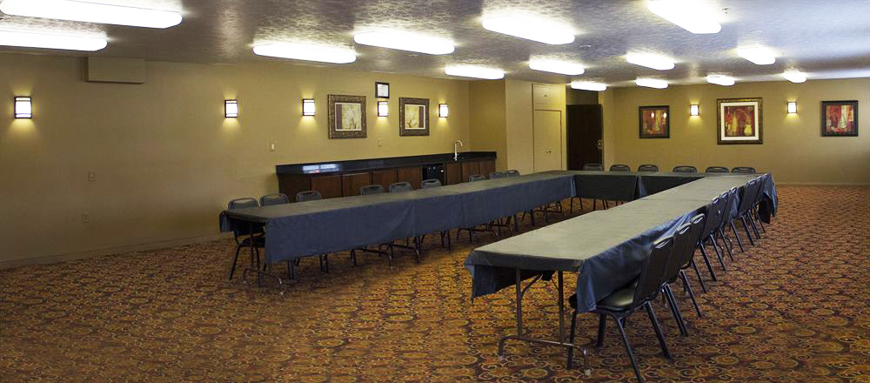
For All Occasions
Meeting Facilities

Slide 8
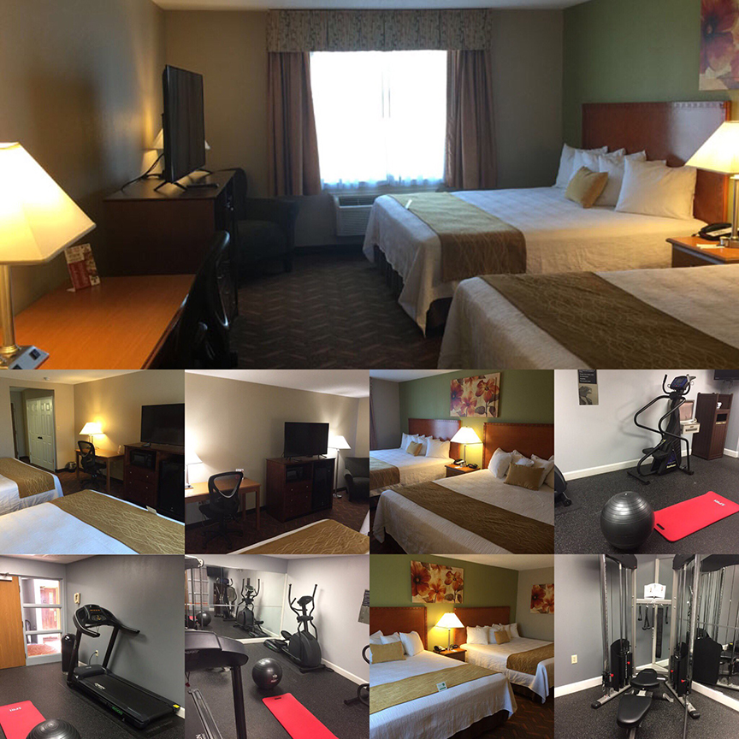
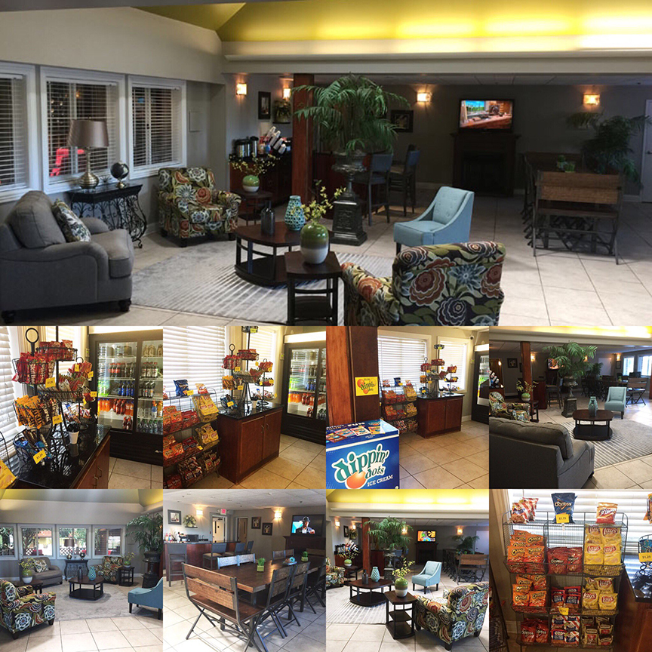
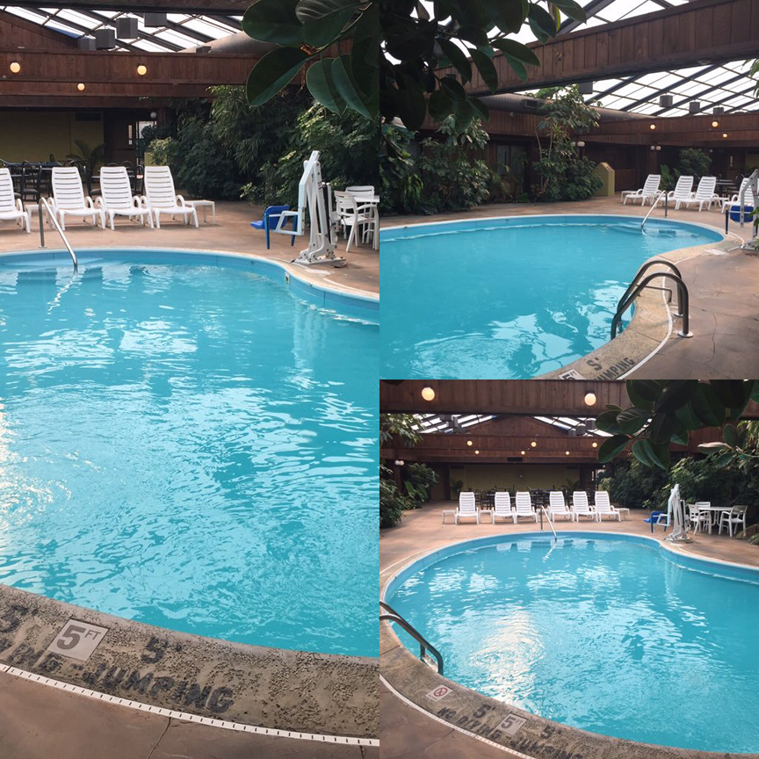
Wingfield Inn & Suites
We Set the Standard in Guest Satisfaction
Todd Pollard / General Manager
todd@wingfeldinnandsuites.com
Jackie Meadors/ Director of Sales
jackie@wingfieldinnandsuites.com
1043 Executive Dr.
Elizabethtown, KY 42701
Front Desk: (270) 769-3030
Fax: (270) 769-2516
reservation@wingfieldinnandsuites.com
www.wingfieldinnandsuites.com

